Slide 1

Online cake ordering system
Sowmya Para 700692587 Akhil Pendem 700694030 Satya.A.P.K.R.Padala 700691883 Sahithi Papireddy 700697117 Sandhyarani Cheelamanthula 700700262

Slide 2

Contents
Introduction
Project Management
Requiremental analysis
Design
Implementation
Testing

Slide 3
Project management
Requirements
Analysis
Design
Implementation
Testing

Slide 4
Infrastructure Used
NetBeans IDE 8.0.2
Web Browser: IE 10 or above, Mozilla FF 31 and above or Google Chrome
Operating System: Windows (Vista/7 or above) / Mac
Java DB

Slide 5
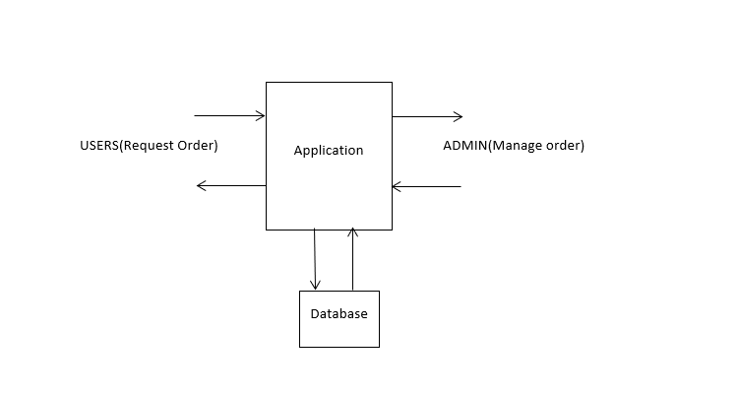
Requirement analysis
By understanding the problems facing with the current system.
We build a basic business model.

Slide 6

Design
Modules
Customer
Booking
Product Function
Web ordering system module
Admin /Employee

Slide 7
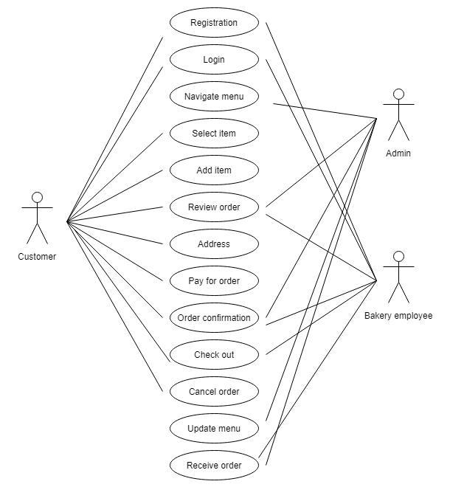
Design – Use case diagram
To Understand the basic need of a feature and the relation between features and actors.

Slide 8
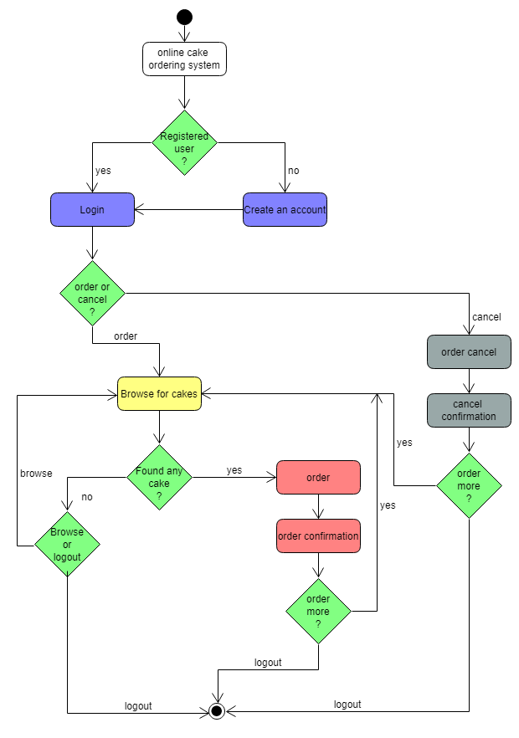
Design –Activity diagram
Represents the flow of Use cases

Slide 9
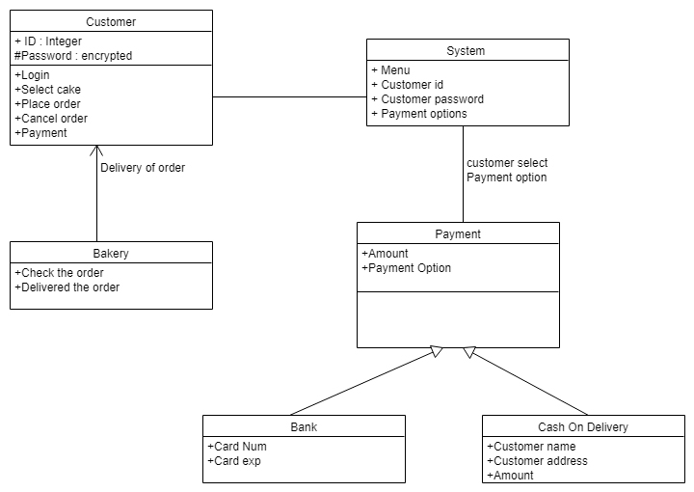
Design -Class Diagram
To determine the structural view of a product

Slide 10
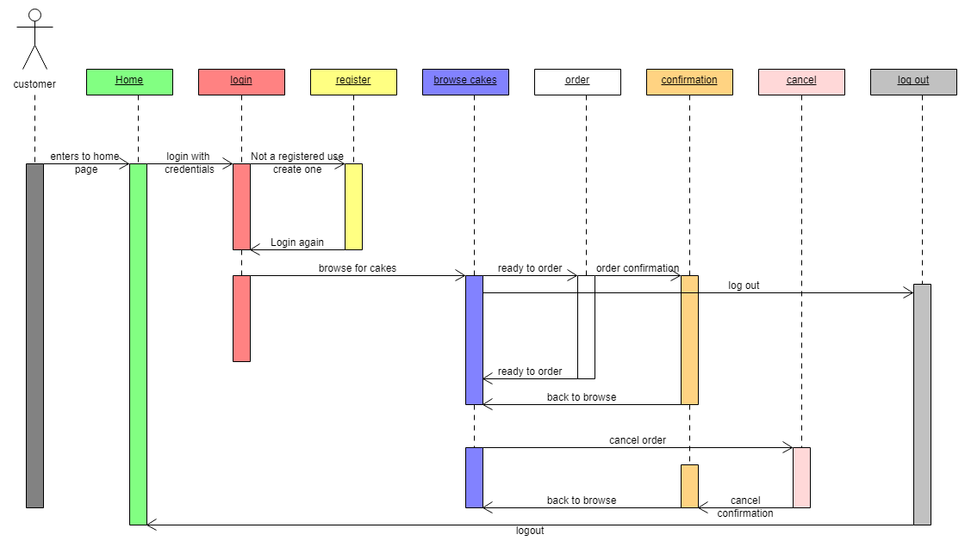
Design –Sequence diagram
To determine Main interaction steps to be achieved for each task i.e. interactions between the classes

Slide 11
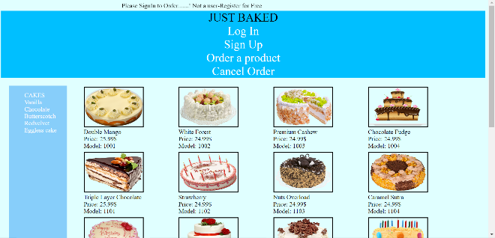
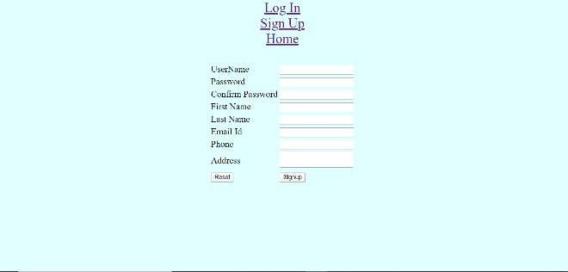

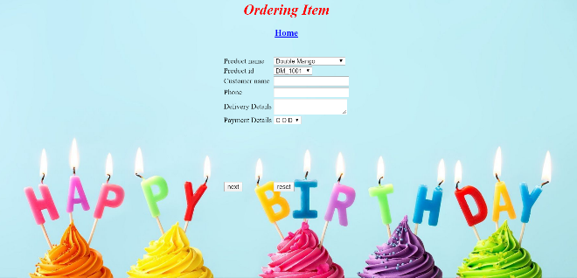
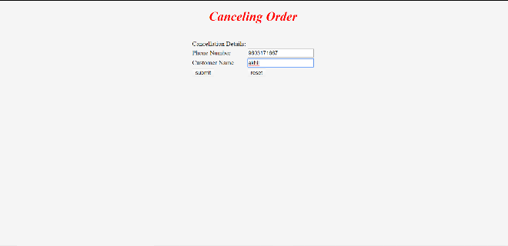
Implementation

Slide 12
Testing
Module | Test case | Expected Result | Status
Login Page | Verifying the Functionality of Login button with Valid Credentials. | User should be able to see the home page with the ability to select a cake and order | PASS
 | Verifying the Functionality of Login button with Invalid Credentials. | User should be able to see a message stating, “Invalid credentials ” and should not allow user to login | PASS
Approach –Test to Specifications
Division – Positive /Negative test cases

Slide 13


Slide 14

Errors which are found during testing phase lead to change in functionality. Should be more cautious while design phase itself to avoid additional costs

Slide 15


